Slide 1
Capacitative measurement of an Andreev bound state in a quantum dot coupled to a floating superconducting island
Filip K. Malinowski (QuTech, TUDelft) Damaz de Jong, Christian Prosko, Lin Han, Michael Chan (QuTech, TUDelft) Luka Pavesic, Rok Žitko (Jozef Stefan Institute) Zoltán Guba, Andras Pályi (Budapest University of Technology and Economics) R. K. Rupesh (University of Hyderabad) Yu Liu (QDev Copenhagen) Jonne V. Koski (MS Delft)
Experiment
Theory
Materials
Consultation
Support and funding:
Materials
Peter Krogstrup (QDev Copenhagen)
Dutch Research Council (NWO)
MS Quantum Lab Delft
Funding

Slide 2
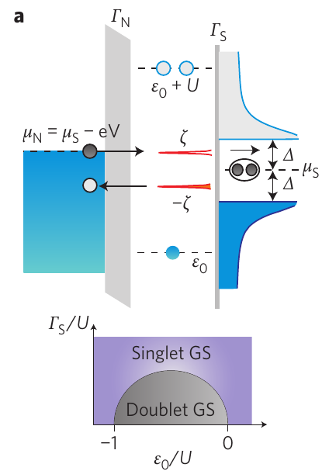
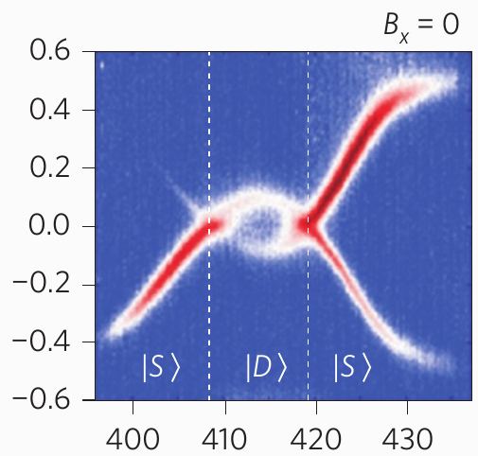
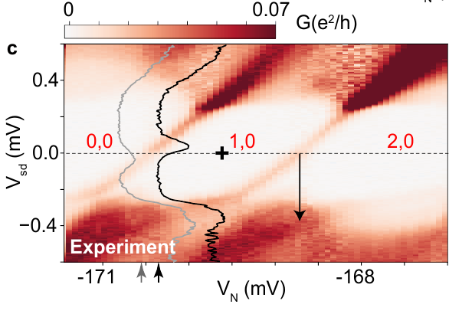
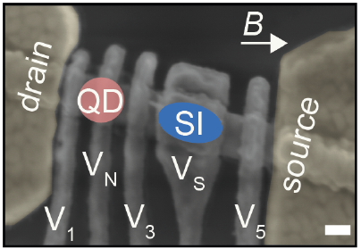
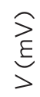
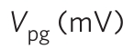
Where we’ve been?
Saldana et al. arXiv:2101.10794
Lee et al. Nat. Nano. 9, 79–84 (2014)

Slide 3
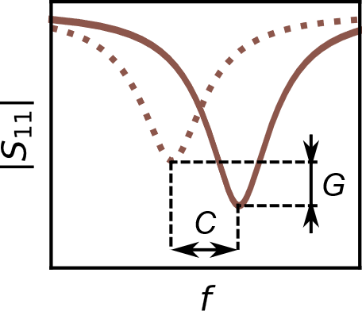
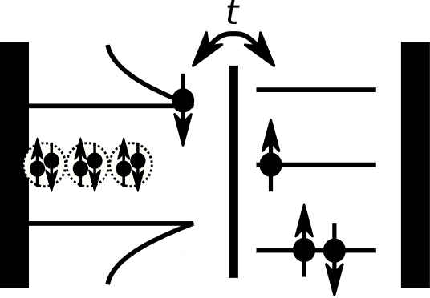
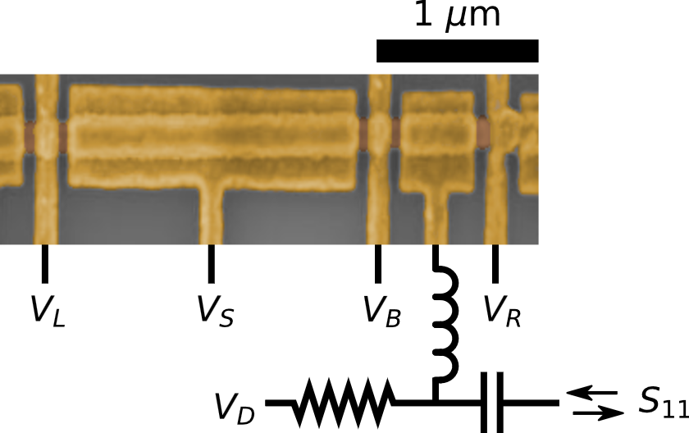
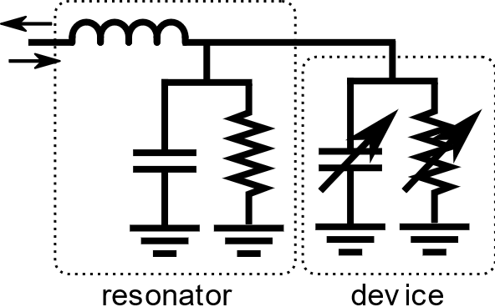
The measurement scheme
f₀ = 368 MHz
semiconducting
dot
superconducting island

Slide 4
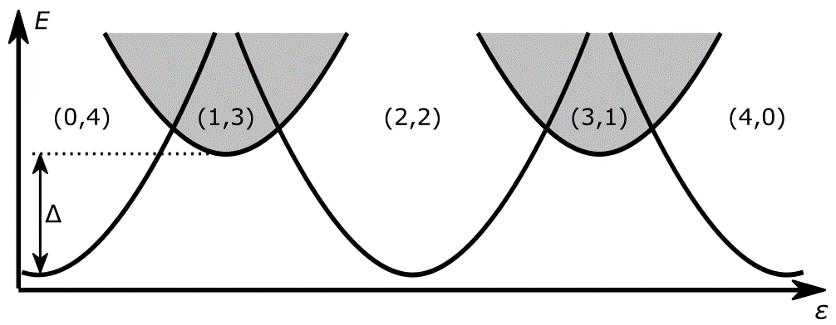
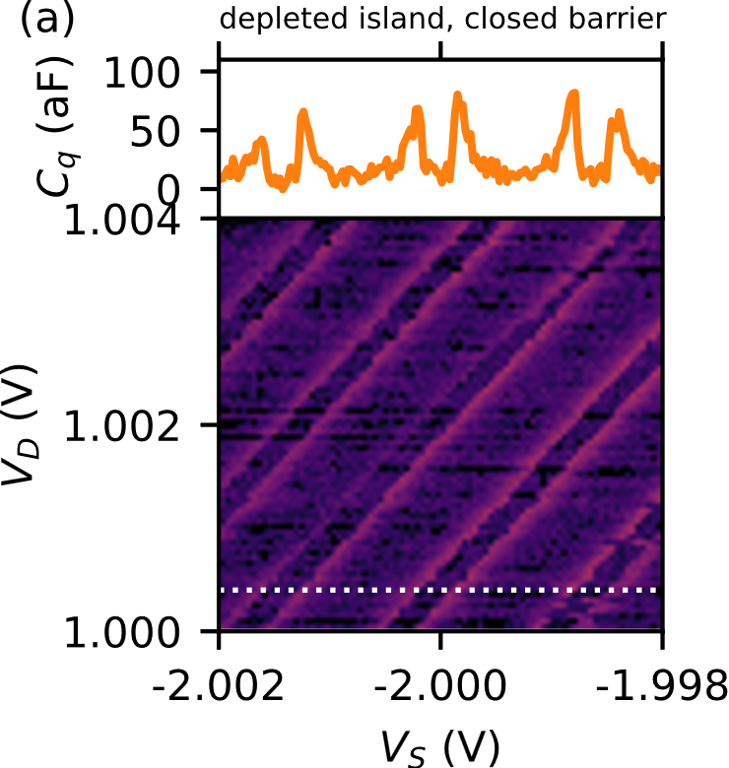
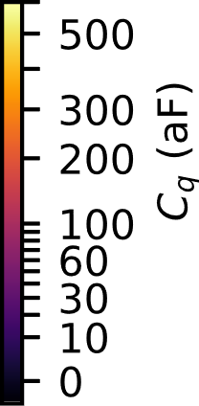
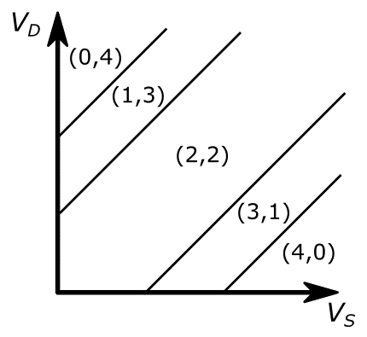
Introducing the charge stability diagrams

Slide 5
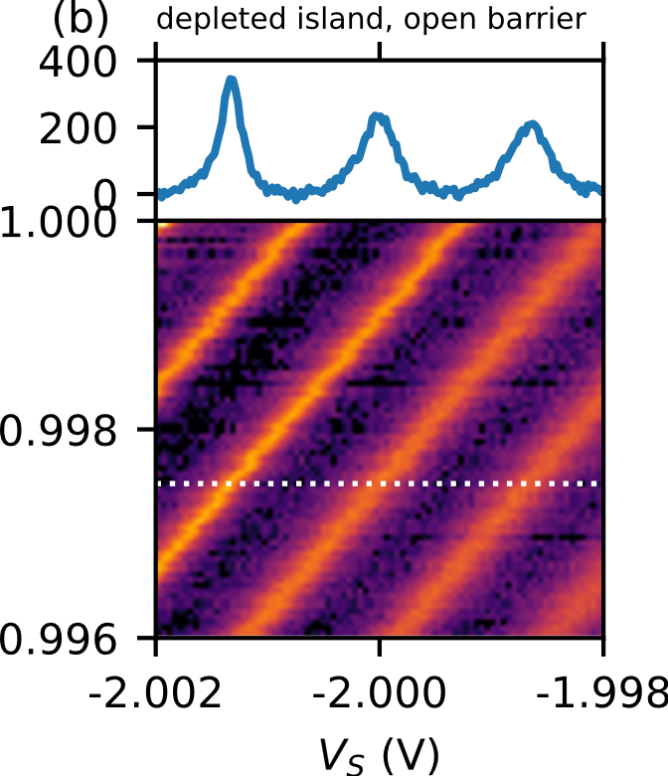
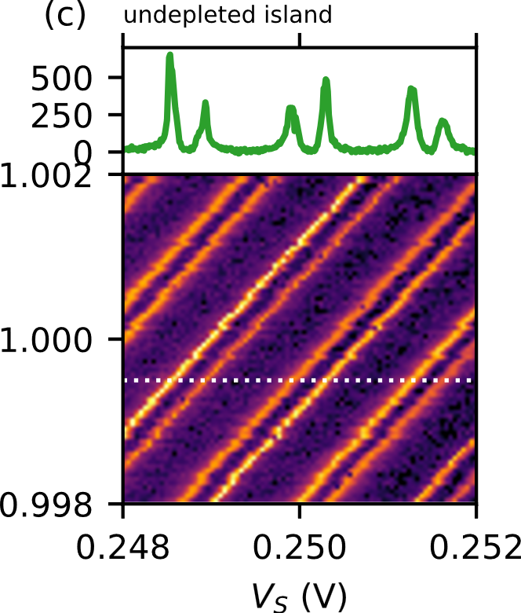
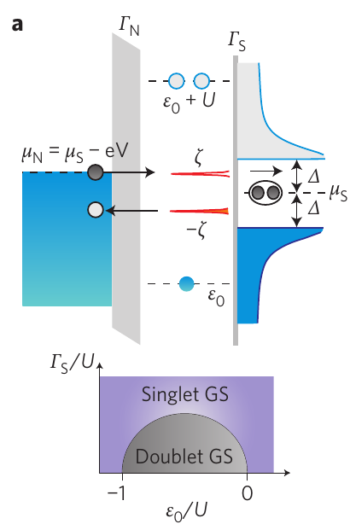
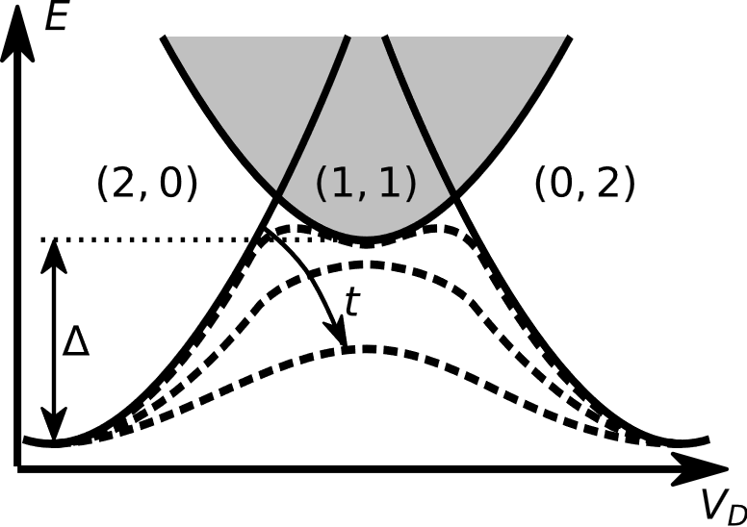
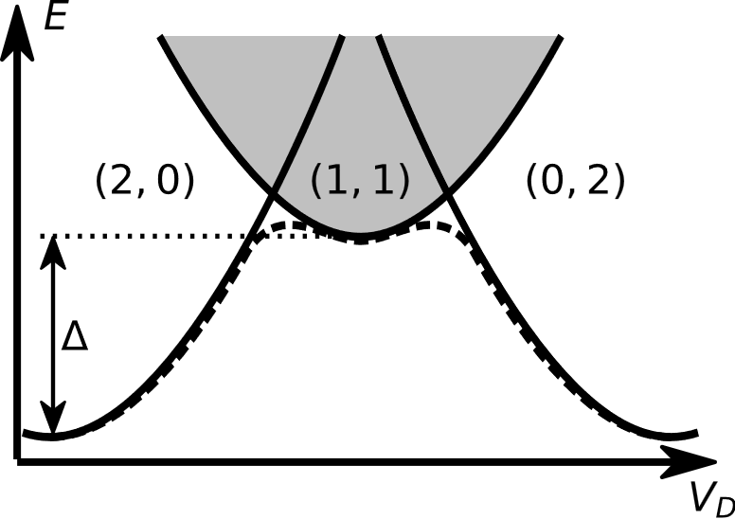


Depleting the semiconductor under the aluminum
semiconducting
dot
superconducting island
Lee et al.
Nat. Nano. 9, 79–84 (2014)

Slide 6
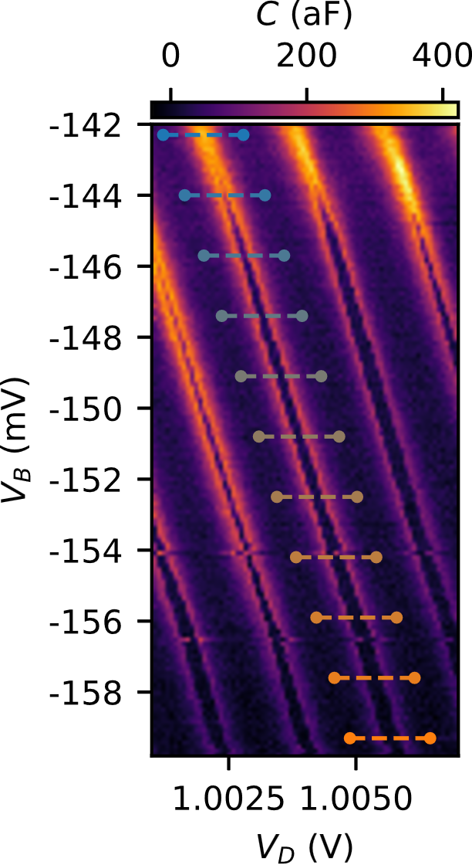
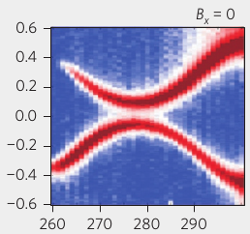
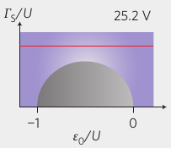
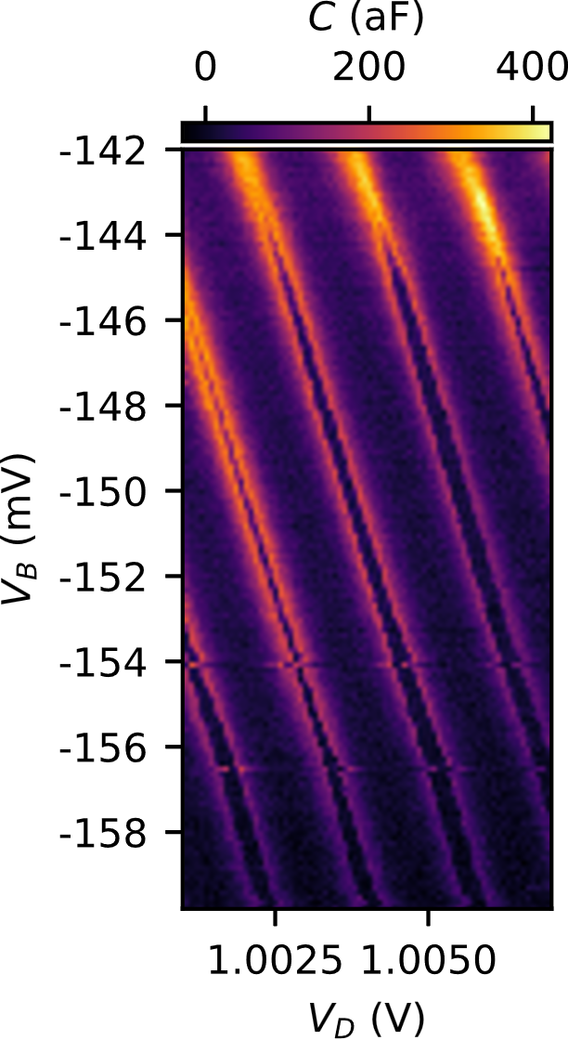
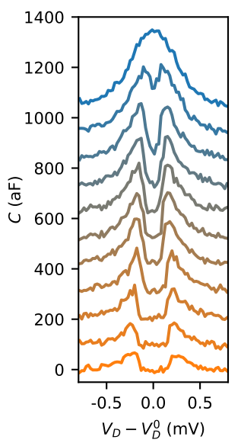
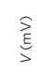
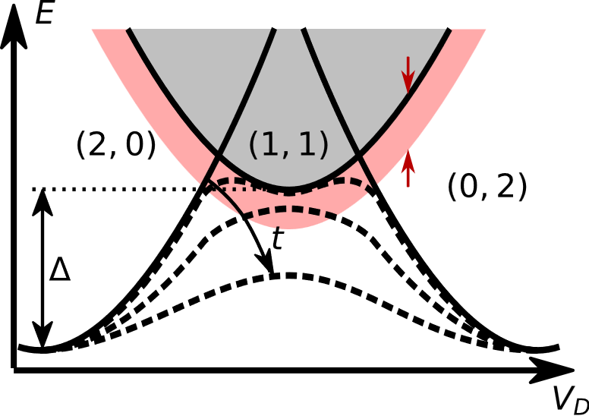
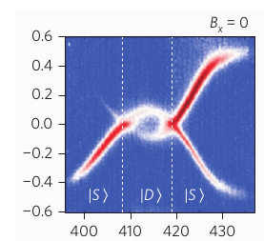
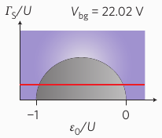
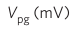
Tuning the tunneling rate
kT ln(N)
Lee et al. Nat. Nano. 9, 79–84 (2014)

Slide 7
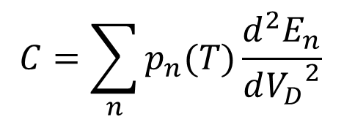
Anderson impurity model
$$H=εn+Un_{↑}n_{↓}+\sum_{k}{ε_{k}n_{k}}+\sum_{k}{Δ(c_{k↑}^{\text{†}}c_{k↓}^{\text{†}}+H.c.)}+\sum_{k,σ}{V(c_{kσ}^{\text{†}}d_{σ}+H.c.)}$$
Eigenstates calculated using projected NRG method
(with fixed parity)
https://github.com/rokzitko/nrgljubljana
kT ln(N)
Quantum capacitance contribution from thermally-occupied eigenstates:
$$C=\sum_{n}{p_{n}(T)\frac{d^{2}E_{n}}{d{V_{D}}^{2}} }$$

Slide 8
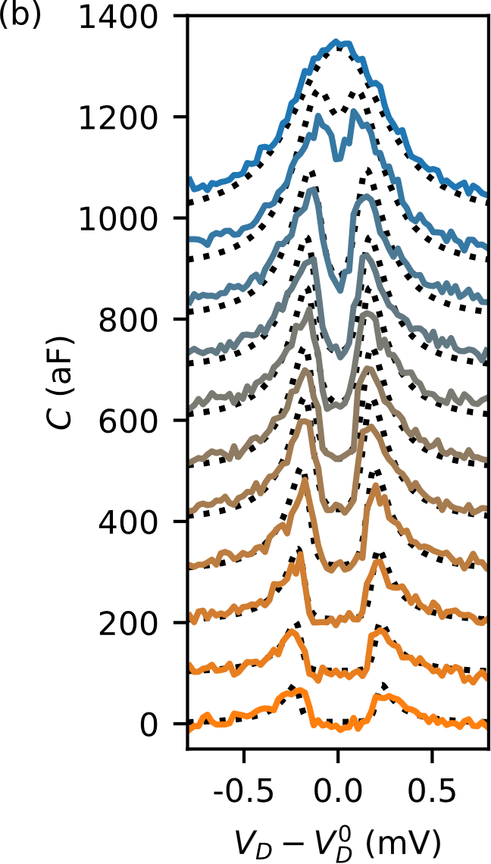
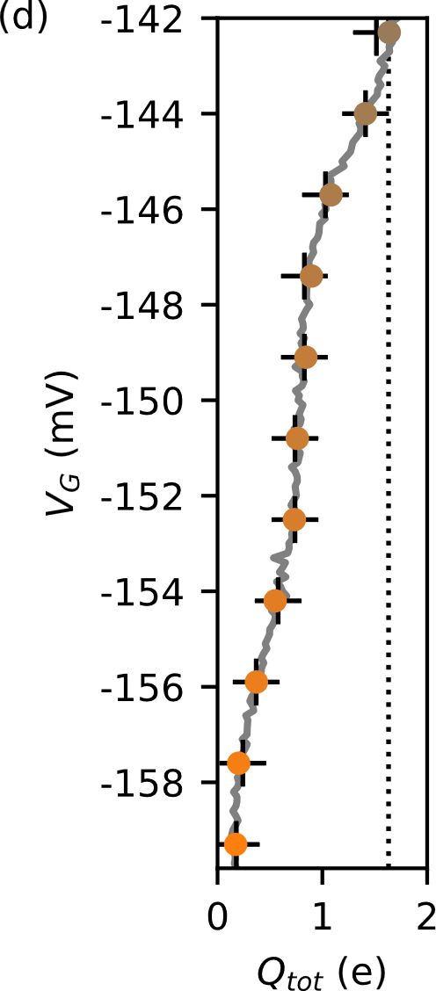
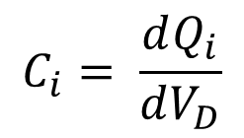
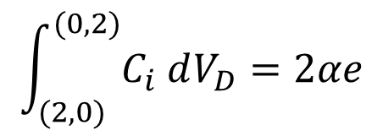
Tuning the tunneling rate
kT ln(N)
$$C_{i}= \frac{dQ_{i}}{dV_{D}}$$
$$\int_{(2,0)}^{(0,2)}{C_{i} dV_{D}}=2αe$$
2αe

Slide 9
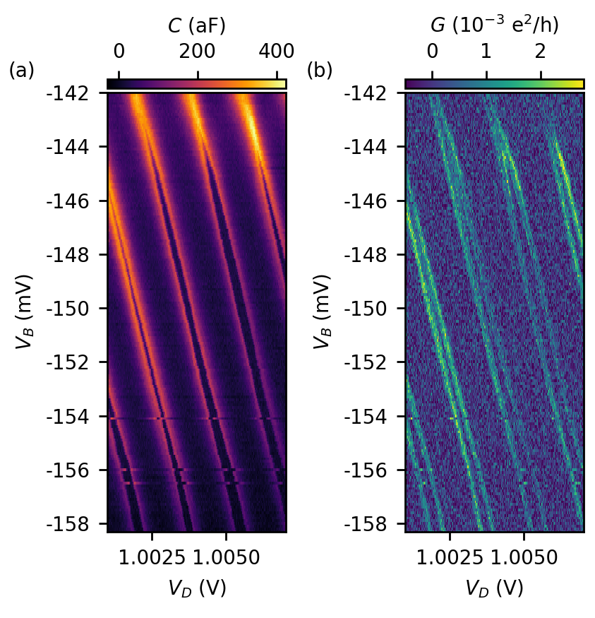
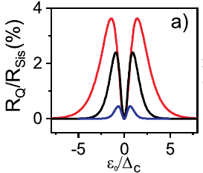
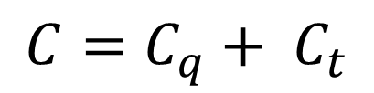
Sisyphus resistance at the charge transitions
$$C=C_{q}+ C_{t}$$
Quantum capacitance
No losses
Tunneling capacitance
Sisyphus resistance
Esterli et al.
APL, 114, 253505 (2019)

Slide 10
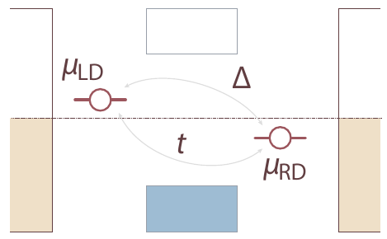
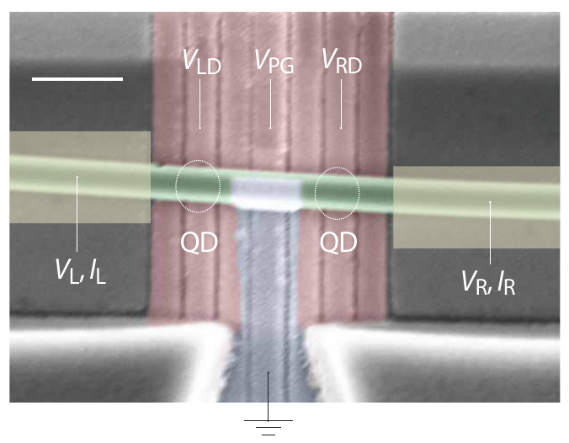
Where are we now?
semiconducting
dot
Proto-Kitaev chain:
Bordin et al. D65.00007
Dvir et al. D65.00008
superconducting island
kT ln(N)

